Slide 1
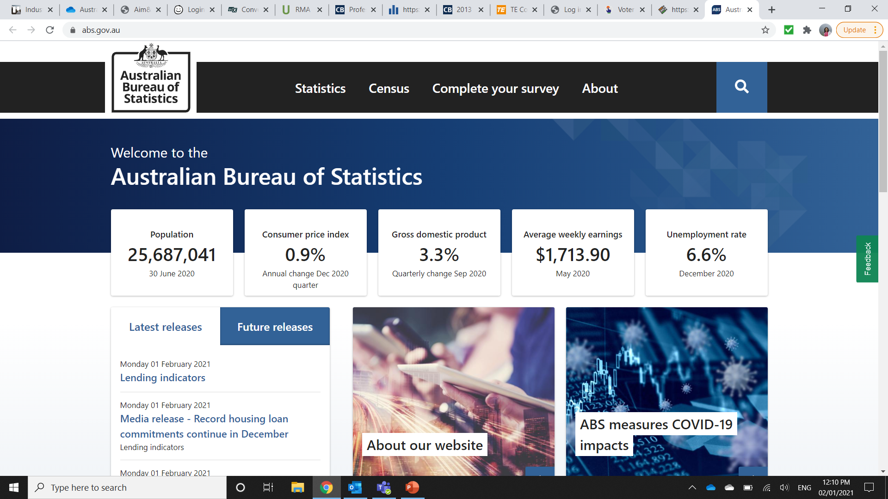
Procedure to obtain PPI data for Australia
Go to:
Click on the “Statistics” tab
www.abs.gov.au

Slide 2
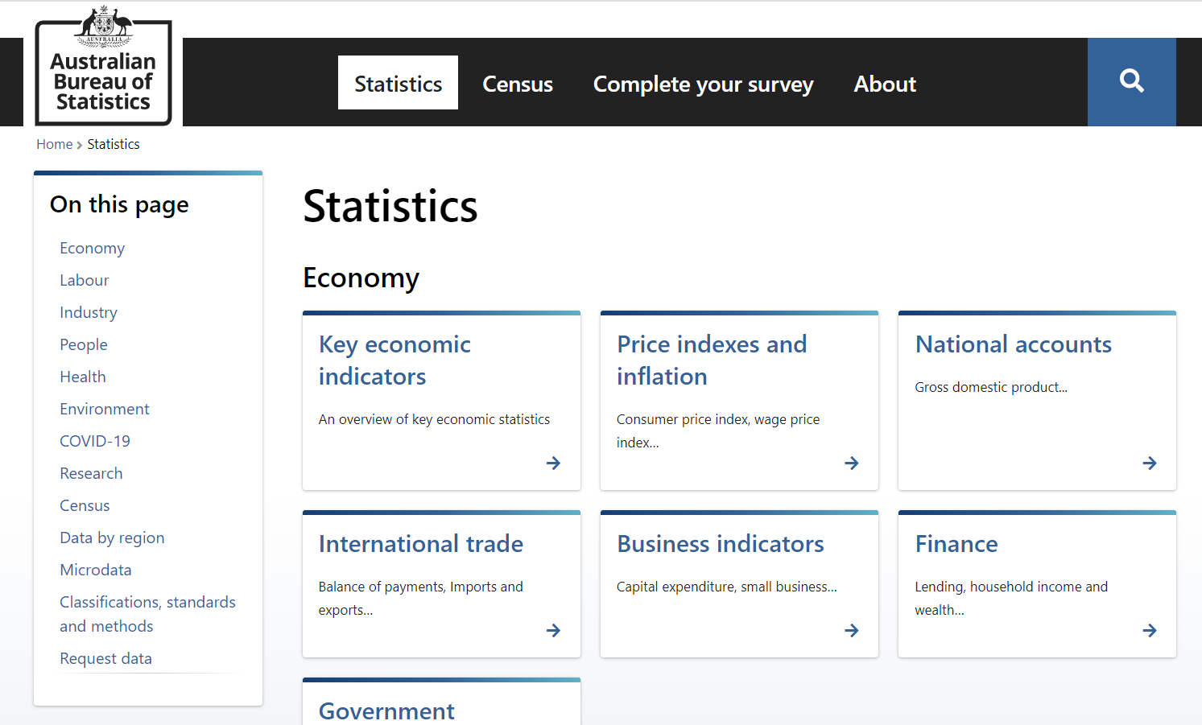
Procedure to obtain PPI data for Australia
Click on “Price Indexes & Inflation” under heading “Economy”

Slide 3
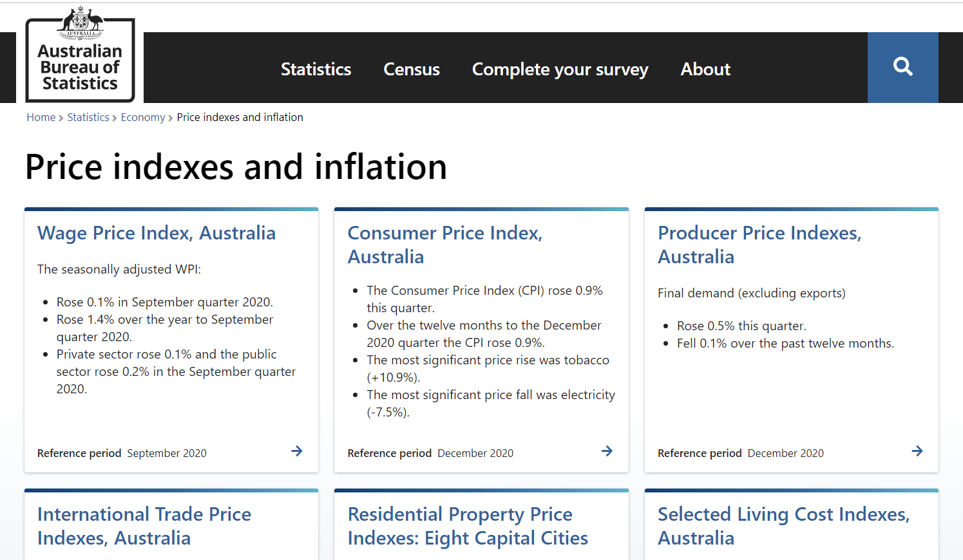
Procedure to obtain PPI data for Australia
Click on “Producer Price Index”
…

Slide 4
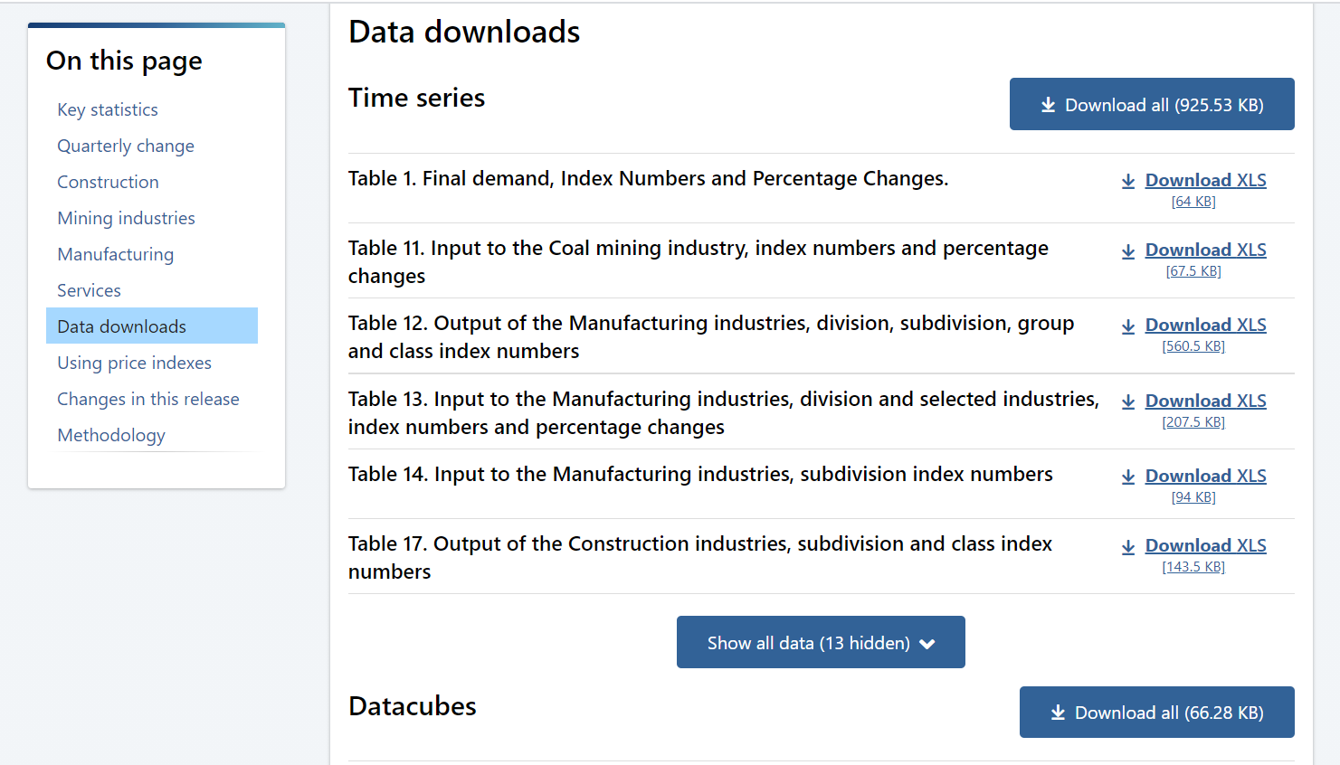
Procedure to obtain PPI data for Australia
Scroll down to the Data Downloads section and select Table 13. Click on Download XLS tab

Slide 5
Procedure to obtain PPI data for Australia
Identify the required index time series in the first tab of the downloaded Excel file
Click on the Series ID link

Slide 6
Procedure to obtain PPI data for Australia
The link will bring you to the relevant column containing the PPI data

